Slide 1
WEEK 9
EXTRA STUFF ON MOLES

Slide 2
MOLES AND CHEMICAL FORMULAS
In the molecular formulas of elements and compounds the subscripts represent the numbers of atoms of each element present in a molecule of the substance.
In one molecule of water(H₂O), there are two atoms of hydrogen and one atom of oxygen.
The subscripts also represent the number of moles of each atom present in one mole of molecules of the substance.

Slide 3
E.g. If there were one mole of water molecules, there would be two moles of hydrogen atoms and one mole of oxygen atoms.
In the case of ionic compounds, e.g. one mole of sodium sulfate (Na₂SO₄) formula units contains 2 moles of sodium ions (Na⁺) and 1 mole of sulfate ions (SO₄²⁻)
Using the relationship between moles and the Avogadro constant, we can calculate the number of individual atoms.

Slide 4
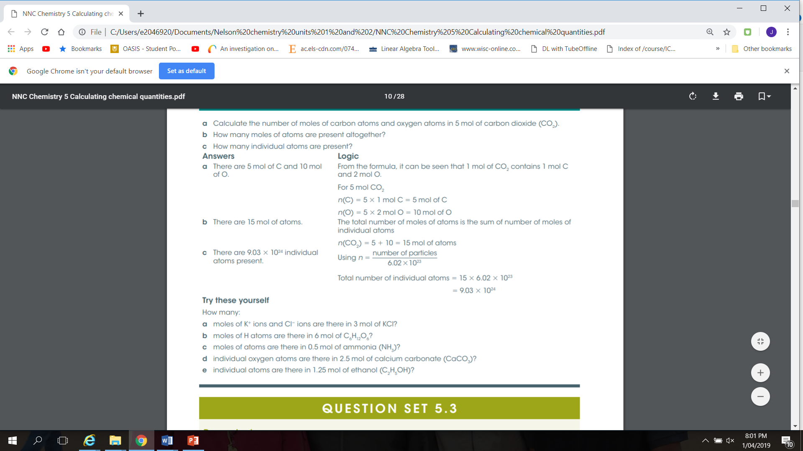

Slide 5
MOLES AND MASS
The mass of 1 mole of a substance is called the molar mass, symbol M. The units of molar mass are grams per mole( g/mol or g mol⁻¹).
One mole of any substance has a mass equal to the relative atomic, molecular or formula mass of that substance expressed in grams.

Slide 6
CONVERTING BETWEEN MOLES AND MASS
Relationship between the number of moles (n), mass(m) and the molar mass(M) of a substance is given by:
Number of moles = mass(g)
        molar mass(g/mol⁻¹)
n = m/M

